Slide 1
Virtual Memory

Slide 2
Objectives
To describe the benefits of a virtual memory system
To explain the concepts of demand paging, page-replacement algorithms, and allocation of page frames
To discuss the principle of the working-set model

Slide 3
Background
We have discussed various memory management strategies that are used in computer systems.
All these strategies have the same goal: to keep many processes in memory simultaneously to allow multi-programming.
Code needs to be in memory to execute, but entire program rarely used
  Error code, unusual routines, large data structures
Entire program code not needed at same time – virtual memory
Consider ability to execute partially-loaded program
  Program no longer constrained by limits of physical memory
  Program and programs could be larger than physical memory

Slide 4
Background
Virtual memory – separation of user logical memory from physical memory
  Only part of the program needs to be in memory for execution
  Logical address space can therefore be much larger than physical address space
  Allows address spaces to be shared by several processes
  Allows for more efficient process creation
  More programs running concurrently
  Less I/O needed to load or swap processes
Virtual memory is not easy to implement, and may substantially decrease performance if it is used carelessly.
Virtual memory can be implemented via:
  Demand paging
  Demand segmentation - more complex to implement since segments size vary.

Slide 5

Virtual Memory That is
Larger Than Physical Memory

Slide 6
Demand Paging
Could bring entire process into memory at load time
Or bring a page into memory only when it is needed – demand paging used in virtual memory systems
Advantages
  Less I/O needed, no unnecessary I/O
  Less memory needed
  Faster response
  More users
Page is needed ⇒ reference to it
  invalid reference ⇒ abort
  not-in-memory ⇒ bring to memory
Lazy swapper – never swaps a page into memory unless page will be needed
  Swapper that deals with pages is a pager
  swapper or sched has process ID 0 and is responsible for paging, and is actually part of the kernel rather than a normal user-mode process.

Slide 7

Transfer of a Paged Memory to
Contiguous Disk Space

Slide 8
Valid-Invalid Bit
When a process is to be swapped in, the pager guesses which pages will be used before the process is swapped out again and brings only those pages into memory
A form of hardware support is needed to distinguish between the pages that are in memory and the pages that are on the disk.
The valid-invalid bit scheme can be used for this purpose.
With each page table entry a valid–invalid bit is associated
(v ⇒ in-memory – memory resident, i ⇒ not-in-memory)
If the bit is set to valid, the associated page is legal
and is present in memory.
If the bit is set to invalid, the page either is not valid
or is valid but is currently on disk.
Initially valid–invalid bit is set to i on all entries
  Or may contain the address of the page on disk
Example of a page table snapshot -----------------→
During address translation, if valid–invalid bit in page table entry
is i ⇒ page fault
Frame #
valid-invalid bit
v
v
v
v
i
….
i
i
page table

Slide 9

Page Table When Some Pages
Are Not in Main Memory

Slide 10
Page Fault
If there is a reference to a page, first reference to that page will trap to operating system: page fault
Procedure for handling page fault:
Operating system looks at an internal table (usually in PCB) to decide:
  Invalid reference ⇒ abort
  Just not in memory
If the reference was invalid, terminate the process, or if valid but we have not yet brought that page in memory then, page it in
Get empty frame from the free frame list
Swap page into frame via scheduled disk operation
When disk read is complete, reset the internal tables to indicate page now in memory: Set validation bit = v
Restart the instruction that caused the page fault

Slide 11

Steps in Handling a Page Fault

Slide 12
Aspects of Demand Paging
Extreme case – start process with no pages in memory
  OS sets instruction pointer to first instruction of process, non-memory-resident -> page fault
  And for every other process pages on first access
  Pure demand paging
Actually, a given instruction could access multiple pages -> multiple page faults
  Pain decreased because of locality of reference
Hardware support needed for demand paging
  Page table with valid / invalid bit
  Secondary memory (swap device with swap space)
  Instruction restart

Slide 13
Performance of Demand Paging
Stages in Demand Paging
Trap to the operating system
Save the user registers and process state
Determine that the interrupt was a page fault
Check that the page reference was legal and determine the location of the page on the disk
Issue a read from the disk to a free frame:
  Wait in a queue for this device until the read request is serviced
  Wait for the device seek and/or latency time
  Begin the transfer of the page to a free frame
While waiting, allocate the CPU to some other user
Receive an interrupt from the disk I/O subsystem (I/O completed)
Save the registers and process state for the other user
Determine that the interrupt was from the disk
Correct the page table and other tables to show page is now in memory
Wait for the CPU to be allocated to this process again
Restore the user registers, process state, and new page table, and then resume the interrupted instruction

Slide 14
Performance of Demand Paging (Cont.)
Page Fault Rate 0 ≤ p ≤ 1
  if p = 0 no page faults
  if p = 1, every reference is a fault
Effective Access Time (EAT)
EAT = (1 – p) x memory access
+ p x (page fault overhead
+ swap page out
+ swap page in
+ restart overhead)

Slide 15
Demand Paging Example
Memory access time = 200 nanoseconds
Average page-fault service time = 8 milliseconds
EAT = (1 – p) x 200 + p (8 milliseconds)
= (1 – p x 200 + p x 8,000,000
= 200 + p x 7,999,800
If one access out of 1,000 causes a page fault, then
EAT = 8.2 microseconds.
This is a slowdown by a factor of 40!!
If want performance degradation < 10 percent
  220 > 200 + 7,999,800 x p
  20 > 7,999,800 x p
  p < .0000025
  < one page fault in every 400,000 memory accesses

Slide 16
Demand Paging Considerations
One additional aspect of demand paging is the handling and overall use of swap space
  Can gain better paging throughput, by copying an entire file image into swap space at process start up and then performing demand paging from the swap space.
        or
  Demand pages from file system initially, but to write the pages to swap space as they are replaced
    This approach will ensure that only needed pages are ever read from the file system, but all subsequent paging is done from swap space
    Swap space is also used for pages including the stack and heap for a process

Slide 17
Copy on write
A process can start quickly by merely demanding in the page containing the first instruction.
But process creation using the fork() system call may initially bypass the need for demand paging by a technique similar to page sharing.
This technique provides for rapid process creation and minimizes the number of new pages that must be allocated to the newly created process.

Slide 18
Copy on write
fork() creates a child process that is a duplicate of its parent.
It creates a copy of the parent’s address space for the child, duplicating the pages belonging to the parent.
Since the child processes usually call exec() immediately after creation, the copying of the parent’s address space may be unnecessary.

Slide 19
Copy-on-Write
Copy-on-Write (COW) allows both parent and child processes to initially share the same pages in memory
  If either process modifies a shared page, only then is the page copied
COW allows more efficient process creation as only modified pages are copied
Example:
  Assume the child process attempts to modify a page containing portions of the stack; the OS recognizes this as a copy-on-write page.
  The OS will then create a copy of this page, mapping it to the address space of the child process.
  Therefore the child process will modify its copied page and not the page belonging to the parent process.

Slide 20

Before Process 1 Modifies Page C

Slide 21

After Process 1 Modifies Page C

Slide 22
Copy-on-Write
Using the copy-on-write technique, it is obvious that only the pages that are modified by either process are copied; all non-modified pages may be shared by the parent and child processes.
Only those pages that may be modified need be marked as copy on write. Pages that cannot be modified (with executable code) may be shared by the parent and child.
In general, free page frames are allocated from a pool of zero-fill-on-demand page frames.
  These are allocated when the stack or heap for a process must expand or for managing copy-on-write pages.
  These demand page frames have been zeroed-out before being allocated, thus erasing the previous contents of the page frame.
  With copy-on-write, the page being copied to a zero-filled page frame.
  Pages allocated for the stack or heap are similarly assigned zero filled page frames.

Slide 23
What Happens if There is no Free Frame?
While user process is executing page fault occurs,.
The OS determines the desired page on disk to bring in, but no free frames in free frame list - Used up by process pages, also in demand from the kernel, I/O buffers, etc
Solution:
Page replacement – find some page in memory, but not really in use, page it out (writing its contents to swap space) and changing the page table to indicate that the page is no longer in main memory.
We can now use the freed frame to hold the page for which the process faulted.

Slide 24

Need For Page Replacement

Slide 25
Basic Page Replacement
Find the location of the desired page on disk
Find a free frame:
- If there is a free frame, use it
- If there is no free frame, use a page replacement algorithm to select a victim frame
- Write victim frame to disk if dirty
Bring the desired page into the (newly) free frame; update the page and frame tables
Continue the process by restarting the instruction that caused the trap
Note: now potentially 2 page transfers for page fault(one out and one in) – increasing EAT
Use modify (dirty) bit for each frame to reduce overhead of page transfers – only modified pages are written to disk, when it is selected for page replacement.

Slide 26

Page Replacement

Slide 27
Page and Frame Replacement Algorithms
To implement demand paging we need to develop
  a frame-allocation algorithm and
  a page replacement algorithm
Frame-allocation algorithm determines
  How many frames to give each process
  Which frames to replace, when page replacement is required
Page-replacement algorithm
  Want lowest page-fault rate to be opted

Slide 28
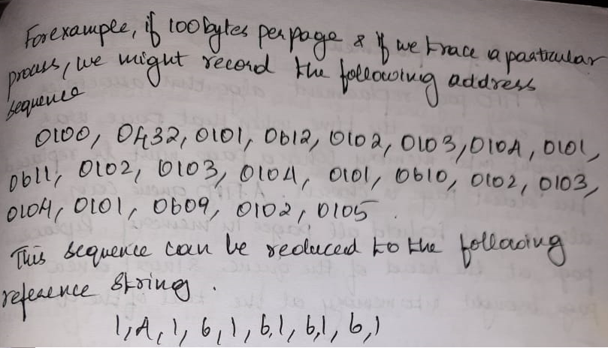
Page and Frame Replacement Algorithms
Evaluate algorithm by running it on a particular string of memory references (reference string) and computing the number of page faults on that string
String is just page numbers, not full addresses
In all our examples, the reference string is
7,0,1,2,0,3,0,4,2,3,0,3,0,3,2,1,2,0,1,7,0,1

Slide 29

Graph of Page Faults Versus
The Number of Frames
To determine the number of page faults for a particular reference string and page replacement algorithm, we also need to know the number of page frames available.
As number of frames available increases, the number of page fault decreases.

Slide 30
Reference String
Reference string is the sequence of pages being referenced
If user has the following sequence of addresses
  123, 215, 600, 1234, 76, 96
If the page size is 100, then the reference string is
  1, 2, 6, 12, 0, 0

Slide 31
First-In-First-Out (FIFO) Algorithm
The oldest page in physical memory is the one selected for replacement
Very simple to implement
  keep a list (FIFO queue)
    Replace the page at the head of the queue
    Insert a new page brought into memory at the tail of the queue

Slide 32
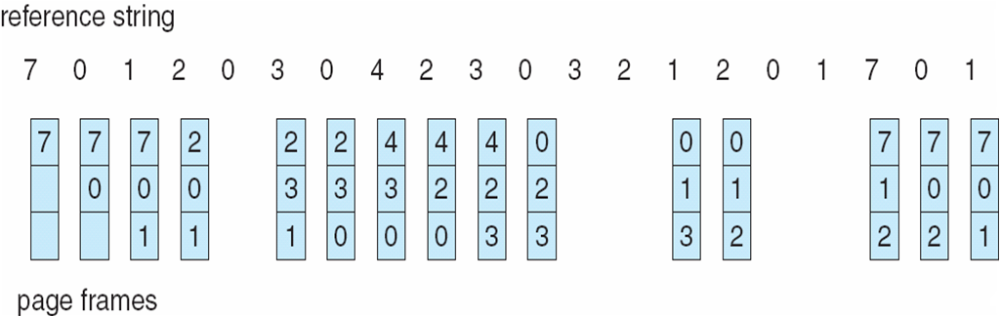
FIFO Page Replacement
Page Fault Rate = Number of Page Faults/Total Number of Page References
= 15 / 20 = 0.75

Slide 33
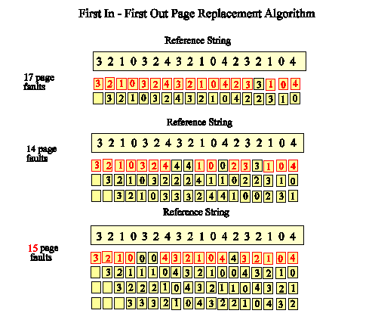
Belady's Anomaly
FIFO Replacement has Belady’s Anomaly – increase in number of page frames increases page faults as in the below scenario

Slide 34
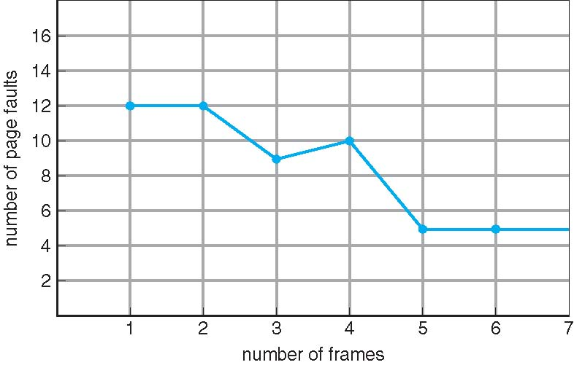
FIFO Illustrating Belady’s Anomaly

Slide 35
FIFO Issues
Poor replacement policy
Evicts the oldest page in the system
  usually a heavily used variable should be around for a long time
  FIFO replaces the oldest page - perhaps the one with the heavily used variable
FIFO does not consider page usage

Slide 36
Optimal Algorithm
Basic idea
  replace the page that will not be referenced for the longest time
This gives the lowest possible fault rate
Impossible to implement
  How do you know the future page references
  Can’t read the future
Used for measuring how well your algorithm performs

Slide 37
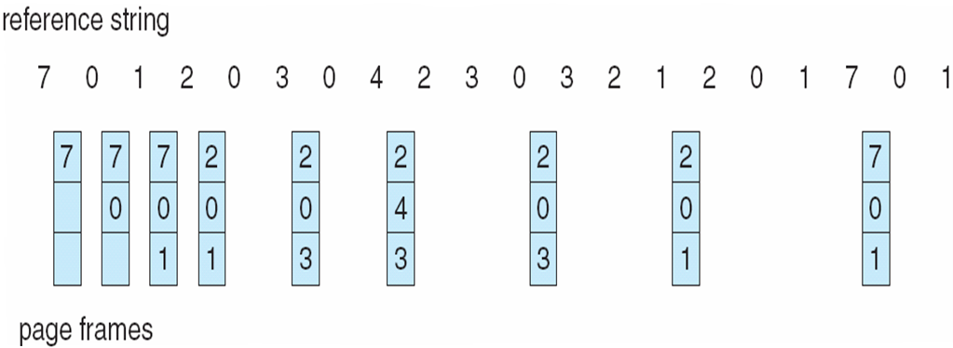
Optimal Page Replacement
Fault Rate = 9 / 20 = 0.45

Slide 38

Least Recently Used (LRU) Algorithm
  Replace the page in memory that has not been accessed for the longest time
Use past knowledge rather than future
Associate time of last use with each page
12 faults – better than FIFO but worse than OPT
Generally good algorithm and frequently used
But how to implement?
Fault Rate = 12/ 20 = 0.6

Slide 39
LRU Algorithm (Cont.)
How to keep track of last page access?
  requires special hardware support
  2 solutions – Counter Implementation and Stack Implementation
Counter implementation
  Every page entry has a counter; every time page is referenced through this entry, copy the clock into the counter
  When a page needs to be changed, look at the counters to find smallest value
    Search through table needed
Stack implementation
  Keep a stack of page numbers in a double link form:
  Page referenced:
    move it to the top
    requires pointers to be changed
  But each update more expensive
  No search for replacement – bottom page of stack to be replaced
LRU and OPT are cases of stack algorithms that don’t have Belady’s Anomaly

Slide 40
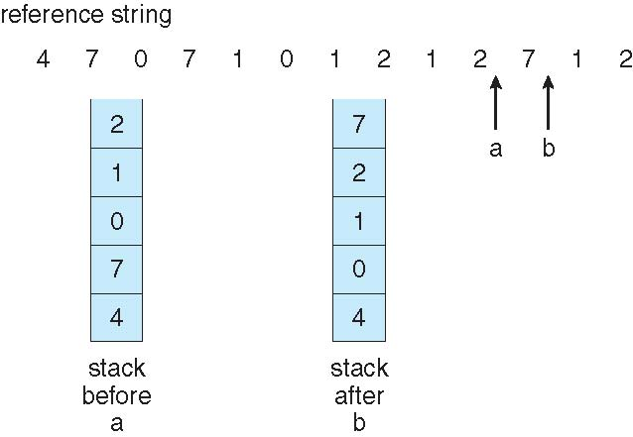
Use Of A Stack to Record The
Most Recent Page References

Slide 41
LRU Issues
Both techniques just listed require additional hardware
  remember, memory reference are very common
  impractical to invoke software on every memory reference
LRU is not used very often
Instead, we will try to approximate LRU
Few computers provide hardware support for true LRU Page replacement
Many systems provide reference bits for LRU approximation.
Initially all bits are cleared by the operating systems, and as user executes the bit associated with the reference bit is set to 1.
Later by examining reference bits, we can determine which pages have been used and which have not been used.
Some LRU approximation algorithms are:
  Second Chance /CLOCK algorithm
  Enhanced Second Chance algorithm
  Additional Reference Bit algorithm

Slide 42
CLOCK / Second-chance algorithm
LRU needs special hardware and still slow
Reference bit
  With each page associate a bit, initially = 0
  When page is referenced bit set to 1
  Replace any with reference bit = 0 (if one exists)
    We do not know the order, however
CLOCK / Second-chance algorithm
  Generally FIFO, plus hardware-provided reference bit
  Clock replacement
  If page to be replaced has
    Reference bit = 0 -> replace it
    reference bit = 1 then:
      set reference bit 0, leave page in memory
      replace next page, whose reference bit is 0

Slide 43
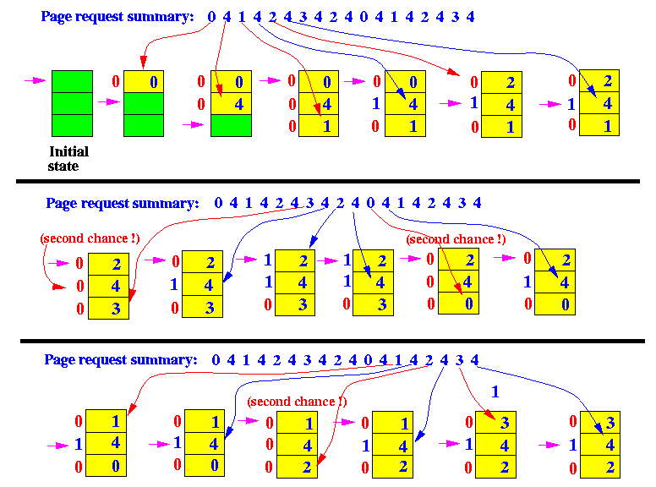
Second Chance / CLOCK replacement
7
7
7

Slide 44
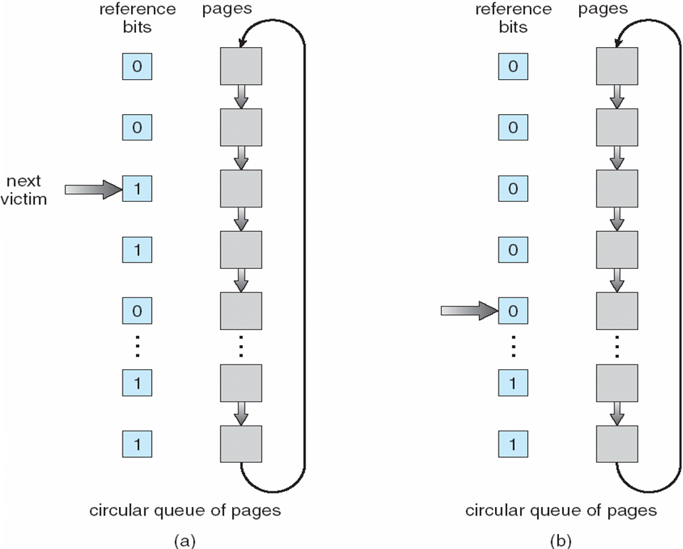
Second-Chance (clock) Page-Replacement Algorithm

Slide 45
Enhanced Second-Chance Algorithm
Consider also the reference bits and the modified bits of pages
  Reference (R) bit: page is referenced in the last interval
  Dirty/Modified (M) bit: page is modified after being loaded into memory
Four possible cases (R,M):
  0,0: neither recently used nor modified
  0,1: not recently used but modified
  1,0: recently used but clean
  1,1: recently used and modified
We replace the first page encountered in the lowest non-empty class.
Rest is the same with second-chance algorithm
We may need to scan the list several times until we find the page to replace

Slide 46
Additional-reference-bits algorithm
Additional ordering information is gained by recording the reference bits at regular intervals
At regular intervals, a timer interrupt transfers control to OS and OS shifts the reference bit for each page to high order bit of 8-bit byte shifting other bits to right by 1 bit
Last 8 time period history of page is stored in this 8 bits.

Slide 47
Contd…
1000000-page not used for the last 8 time periods
11111111-page used once in each time period
11000100-used recently
10111011-not used recently
The page with a lowest number(integer) is the LRU page.

Slide 48
Counting Algorithms
Keep a counter of the number of references that have been made to each page
  Not common
LFU Algorithm(least frequently used): replaces page with smallest count
MFU Algorithm(most frequently used): based on the argument that the page with the smallest count was probably just brought in and has yet to be used

Slide 49
Page-Buffering Algorithms
Keep a pool of free frames, always
  Then frame available when needed, not found at fault time
  Read page into free frame and select victim to evict and add to free pool
  When convenient, evict victim
Possibly, keep list of modified pages
  When backing store otherwise idle, write pages there and set to non-dirty
Possibly, keep free frame contents intact and note what is in them
  If referenced again before reused, no need to load contents again from disk
  Generally useful to reduce penalty if wrong victim frame selected

Slide 50
Dirty Pages
If a page has been written to, it is dirty – Dirty bit for page in page table set to 1
Before a dirty page can be replaced it must be written to disk
A clean page does not need to be written to disk
  the copy on disk is already up-to-date
We would rather replace an old, clean page than and old, dirty page

Slide 51
Cleaning Policy
A cleaning policy is concerned with determining when a modified page should be written out to secondary memory.
Demand cleaning
  A page is written out only when it has been selected for replacement
Precleaning
  Pages are written out in batches
Notes:
A cleaning policy is the opposite of a fetch policy; it is concerned with determining when a modified page should be written out to secondary memory.
With demand cleaning, a page is written out to secondary memory only when it has been selected for replacement.
A precleaning policy writes modified pages before their page frames are needed so that pages can be written out in batches.

Slide 52
Cleaning Policy
Best approach uses page buffering
Replaced pages are placed in two lists
  Modified and unmodified
Pages in the modified list are periodically written out in batches
Pages in the unmodified list are either reclaimed if referenced again or lost when its frame is assigned to another page
Notes:
Clean only pages that are replaceable, but decouple the cleaning and replacement operations.
With page buffering, replaced pages can be placed on two lists:
modified and unmodified.
The pages on the modified list can periodically be written out in batches and moved to the unmodified list.
A page on the unmodified list is either reclaimed if it is referenced, or lost when its frame is assigned to another page.

Slide 53
Allocation of Frames
Each process needs minimum number of frames
Maximum of course is total frames in the system
Two major allocation schemes
  fixed allocation
  priority allocation
Many variations of schemes also available

Slide 54
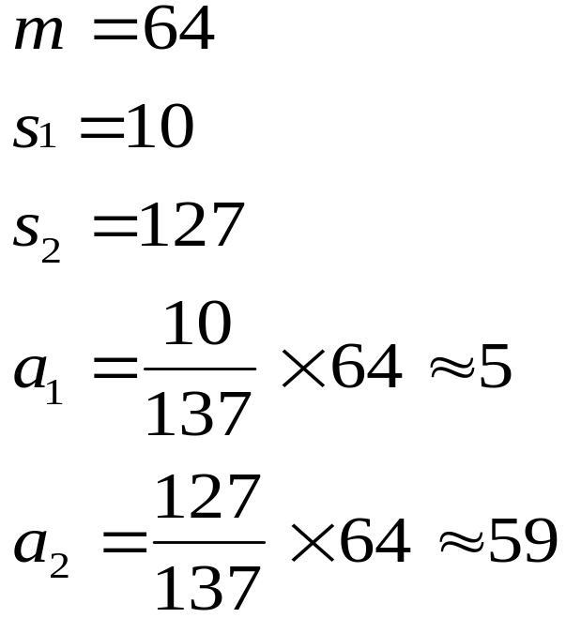

Fixed Allocation
Equal allocation – For example, if there are 100 frames (after allocating frames for the OS) and 5 processes, give each process 20 frames
  Can also keep some as free frame buffer pool
Proportional allocation – Allocate according to the size of process
  Dynamic as degree of multiprogramming, process sizes change

Slide 55
Priority Allocation
Use a proportional allocation scheme using priorities rather than size
If process P_{i} generates a page fault,
  select for replacement one of its frames
  select for replacement a frame from a process with lower priority number

Slide 56
Global vs. Local Allocation
Global replacement – process selects a replacement frame from the set of all frames; one process can take a frame from another – page stealing
  But then process execution time can vary greatly
  But greater throughput so more common
Local replacement – each process selects from only its own set of allocated frames
  More consistent per-process performance
  But possibly underutilized memory

Slide 57
Thrashing
If a process does not have “enough” pages in main memory, the page-fault rate is very high
  Page fault to get page
  Replace existing page in a frame
  But quickly need replaced page back
  This leads to:
    Low CPU utilization
    Operating system thinking that it needs to increase the degree of multiprogramming- bringing more processes into memory
    Another process added to the system
    Degree of multiprogramming taken care of by long term scheduler
    Global page replacement also leads to thrashing
Thrashing ≡ a process is busy swapping pages in and out

Slide 58

Thrashing (Cont.)

Slide 59
Thrashing
If the number of frames allocated to a low-priority process falls below the minimum number required by the computer architecture, we must suspend that process’s execution.
We should then page out its remaining pages, freeing all its allocated frames.
This provision introduces a swap-in, swap-out level of intermediate CPU scheduling ( medium term scheduler).
And the process can be restarted later when required number of frames are available for its execution.
This prevents thrashing for this process.

Slide 60
Demand Paging and Thrashing
How does demand paging work?
Locality model
Resident Set - The set of pages of a process that are currently in main memory
Locality of Reference - A locality is a set of pages that are actively used together
  Process migrates from one locality to another, during function calls
  Suppose we allocate enough frames to a process to accommodate its current locality. It will fault for the pages in its locality until all these pages are in memory; then, it will not fault again until it changes localities. If we do not allocate enough frames to accommodate the size of the current locality, the process will thrash, since it cannot keep in memory all the pages that it is actively using.
Why does thrashing occur? - Σ size of locality > total memory size
Prevent Thrashing
  By providing a process with as many frames as it needs. But how do we know how many frames it "needs"? There are several techniques. The working-set strategy starts by looking at how many frames a process is actually using.
  By using local or priority page replacement, if one process starts thrashing, it cannot take frames from another process and cause the latter to thrash as well.

Slide 61
Working-Set Model
Δ ≡ working-set window ≡ a fixed number of page references
Example: 10
WSS_{i} (working set of Process P_{i}) = total number of pages referenced in the most recent Δ (varies in time)
  if Δ too small will not encompass entire locality
  if Δ too large will encompass several localities
  if Δ = ∞ ⇒ will encompass entire program
Total demand frames D = Σ WSS_{i} and Total Available frames is m
Then if D > m ⇒ Thrashing
Policy if D > m, then suspend or swap out one of the processes

Slide 62

Working-set model

Slide 63
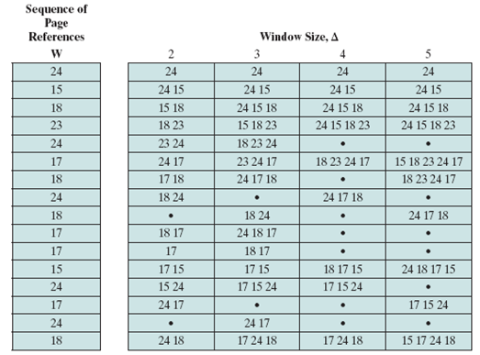
Working-set model

Slide 64
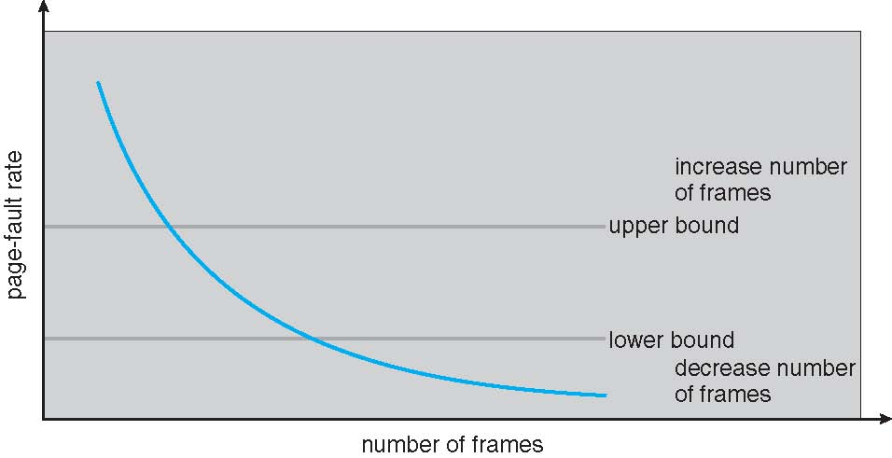
Page-Fault Frequency
More direct approach than WSS
Establish “acceptable” page-fault frequency rate and use local replacement policy
  If actual rate too low, process loses frame
  If actual rate too high, process gains frame

Slide 65

Working Sets and Page Fault Rates

Slide 66
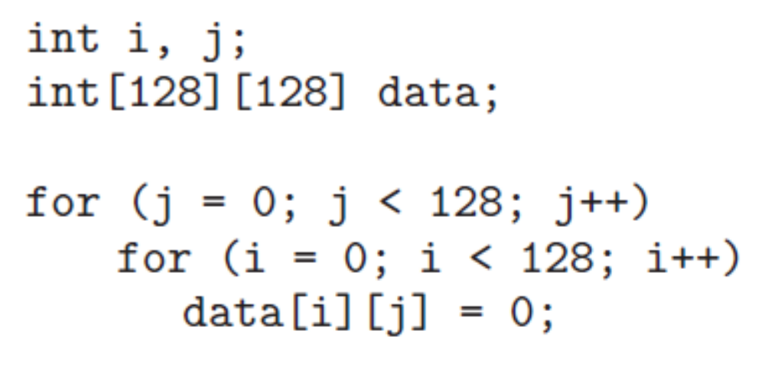
Program Structure
Demand paging is designed to be transparent to the user program.
In many cases, the user is completely unaware of the paged nature of memory.
In other cases, however, system performance can be improved if the user (or compiler) has an awareness of the underlying demand paging.
Let’s look at a contrived but informative example. Assume that pages are 128 words in size.
Consider a C program whose function is to initialize to 0 each element of a 128-by-128 array. The following code is typical:

Slide 67
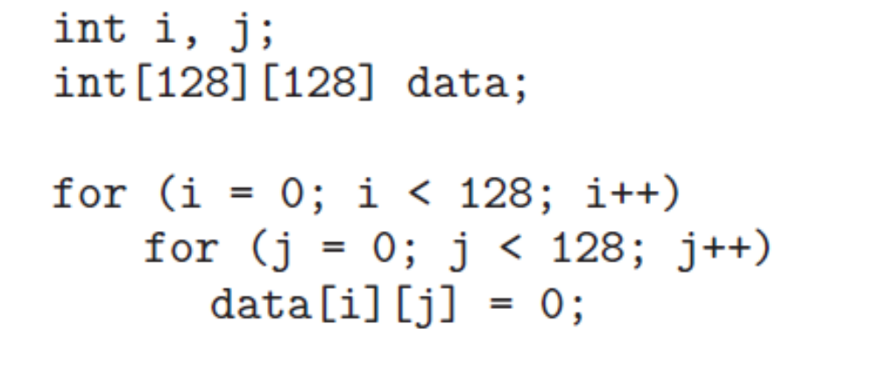
Program Structure
Notice that the array is stored row major; that is, the array is stored data[0][0], data[0][1], · · ·, data[0][127], data[1][0], data[1][1], · · ·, data[127][127].
For pages of 128 words, each row takes one page. Thus, the preceding code zeros one word in each page, then another word in each page, and so on.
If the operating system allocates fewer than 128 frames to the entire program, then its execution will result in 128 × 128 = 16,384 page faults.
In contrast, suppose we change the code to
This code zeros all the words on one page before starting the next page, reducing the number of page faults to 128.

Slide 68
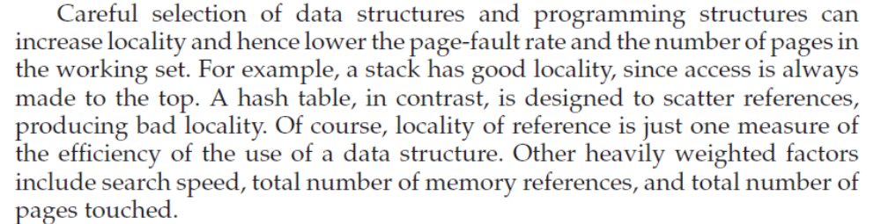
Program Structure

Slide 69
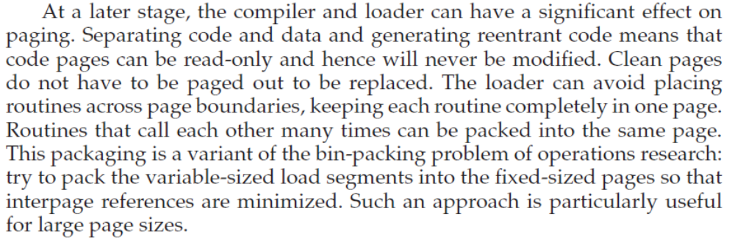
Program Structure

Slide 70
Demand Paging and Prepaging
Demand paging
  only brings pages into main memory when a reference is made to a location on the page
  Many page faults when process first started
Prepaging
  brings in more pages than needed
  More efficient to bring in pages that reside contiguously on the disk
  Don’t confuse with “swapping”
Notes:
With demand paging,
A page is brought into main memory only when a reference is made to a location on that page.
When a process is first started, there will be a flurry of page faults.
As more and more pages are brought in, the principle of locality suggests that most future references will be to pages that have recently been brought in.
Thus, after a time, matters should settle down and the number of page faults should drop to a very low level.
With prepaging,
Pages other than the one demanded by a page fault are brought in.
If the pages of a process are stored contiguously in secondary memory, then it is more efficient to bring in a number of contiguous pages at one time rather than bringing them in one at a time over an extended period.
Of course, this policy is ineffective if most of the extra pages that are brought in are not referenced.
The prepaging policy could be employed either when a process first starts up, in which case the programmer would somehow have to designate desired pages, or every time a page fault occurs.
The latter would seem preferable because it is invisible to the programmer.
However, the utility of prepaging has not been established.
Prepaging should not be confused with swapping.
When a process is swapped out of memory and put in a suspended state, all of its resident pages are moved out.
When the process is resumed, all of the pages that were previously in main memory are returned to main memory.

Slide 71
Page Size
Page sizes are invariably powers of 2, generally ranging from 512 (2^9) to 2048 Bytes.
Why are page sizes always in powers of 2?
  Recall that paging is implemented by breaking up an address into a page and offset number. It is most efficient to break the address into X page bits and Y offset bits, rather than perform arithmetic on the address to calculate the page number and offset. Because each bit position represents a power of 2, splitting an address between bits results in a page size that is a power of 2.

Slide 72
How to select a page size?
One concern is the size of the page table
For a given virtual memory space, decreasing the page size increases the number of pages and hence the size of the page table.
For a virtual memory of 4 MB (2^22), for example, there would be 4,096 pages of 1,024 bytes but only 512 pages of 8,192 bytes.
Because each active process must have its own copy of the page table, a large page size is desirable.

Slide 73
How to select a page size?
Another concern is to minimize internal fragmentation in the last page.
Assuming independence of process size and page size, we can expect that, on the average, half of the final page of each process will be wasted.
This loss is only 256 bytes for a page of 512 bytes but is 4,096 bytes for a page of 8,192 bytes.
To minimize internal fragmentation, then, we need a small page size.

Slide 74
How to select a page size?
Another problem is the time required to read or write a page.
I/O time is composed of seek, latency, and transfer times.
Transfer time is proportional to the amount transferred (that is, the page size)—a fact that would seem to argue for a small page size.
If, It takes 28.4 milliseconds to read a single page of 1,024 bytes but 56.4 milliseconds to read the same amount as two pages of 512 bytes each.
Thus, a desire to minimize I/O time argues for a larger page size.

Slide 75
How to select a page size?
Another concern is, with a smaller page size, though, total I/O should be reduced, since locality will be improved.
A smaller page size allows each page to match program locality more accurately.
For example, consider a process 200 KB in size, of which only half (100 KB) is actually used in an execution.
If we have only one large page, we must bring in the entire page, a total of 200 KB transferred and allocated.
If instead we had pages of only 1 byte, then we could bring in only the 100 KB that are actually used, resulting in only 100 KB transferred and allocated.
With a smaller page size, then, we have better resolution, allowing us to isolate only the memory that is actually needed.
With a larger page size, we must allocate and transfer not only what is needed but also anything else that happens to be in the page, whether it is needed or not.
Thus, a smaller page size should result in less I/O and less total allocated memory.

Slide 76
How to select a page size?
The problem has no best answer.
As we have seen, some factors (internal fragmentation, locality) argue for a small page size, whereas others (table size, I/O time) argue for a large page size.
Nevertheless, the historical trend is toward larger page sizes.
Modern systems may now use much larger page sizes.

Slide 77
Memory-Mapped Files
Memory-mapped file I/O allows file I/O to be treated as routine memory access by mapping a disk block to a page in memory.
A file is initially read using demand paging. A page-sized portion of the file is read from the file system into a physical page. Subsequent reads/writes to/from the file are treated as ordinary memory accesses.
Simplifies file access by treating file I/O through memory rather than read() write() system calls.
Also allows several processes to map the same file allowing the pages in memory to be shared.
Operating System Concepts

Slide 78
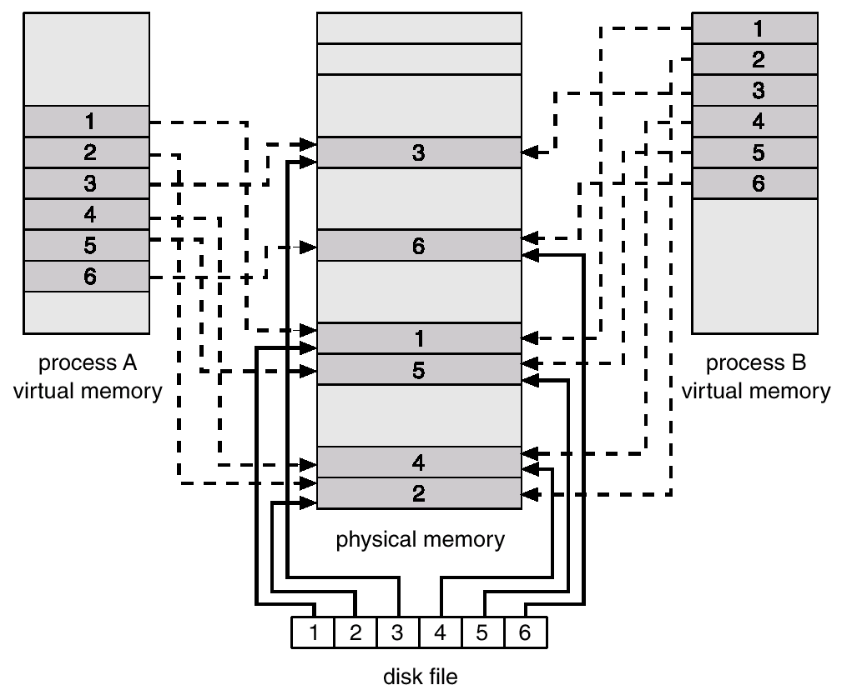
Memory Mapped Files
Operating System Concepts

